Slide 1
Warmly welcome, students of Speaking AE2 ☺
COURSE ORIENTATION
Đỗ Thị Diệu Ngọc
School of Languages
dtdngoc@hcmiu.edu.vn

Slide 2
INTRODUCTION TO SPEAKING AE2
COURSE DESCRIPTION
Speaking AE2 provides students with the knowledge and skills needed to deliver effective presentations by:
building up confidence
preparing and planning
using the appropriate language
applying effective visual aids
performing body language
dealing with questions and responding to them

Slide 3



INTRODUCTION TO AE2 SPEAKING (cont’d)
RESOURCES
Textbook
Additional materials (AM)

Slide 4
Resources
a. Textbook:
Lowe, S, & Pile, L. (2010). Presenting. Cengage Learning
b. Additional materials (AM):
Jeremy Comfort (1997). Effective Presentations. Oxford University Press
Stephen Lucas (2014). The Art of Public Speaking (12th edition). McGraw-Hill Education
c. Reference book:
Harrington, D. & Lebeau, C. (2009). Speaking of Speech. Macmillan

Slide 5
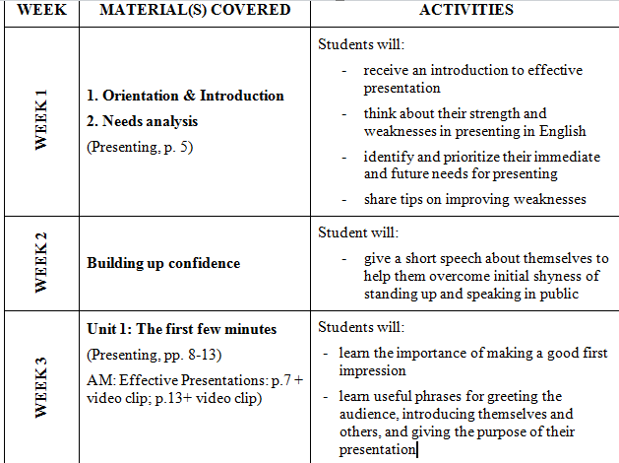
Specific sessions

Slide 6
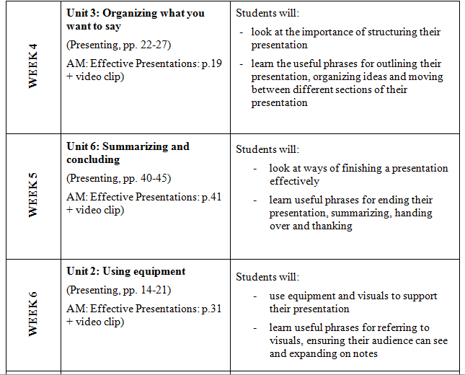
Specific sessions

Slide 7
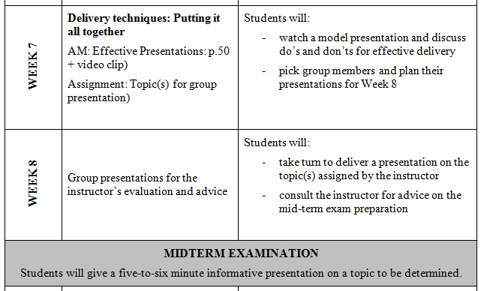
Specific sessions

Slide 8
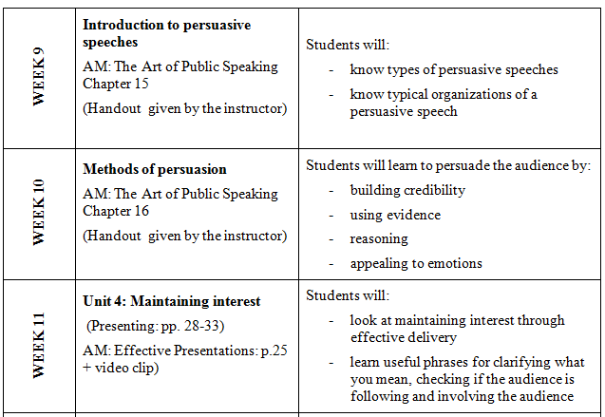
Specific sessions

Slide 9
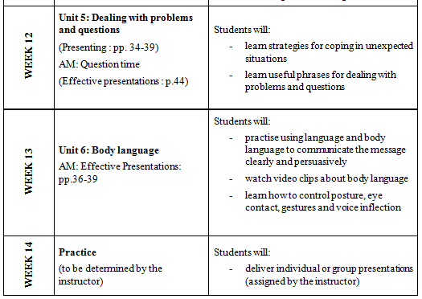
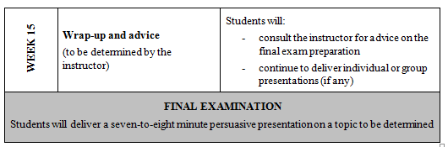
Specific sessions

Slide 10
ASSESSMENT
No. | Assessment Task | Scoring | Weighting
1 | On-going Assessment (discussion, group presentation, individual presentation, and so on) (It is requested that lecturers collect students’ scripts or any type of evidence of their participation for fact check). | Out of 100 | 30%
3 | Mid-term Exam (Students will give a five-to-six minute informative presentation on a topic to be determined) | Out of 100 | 30%
4 | Final Exam (Students will deliver a seven-to-eight minute persuasive presentation on a topic to be determined.) | Out of 100 | 40%

Slide 11

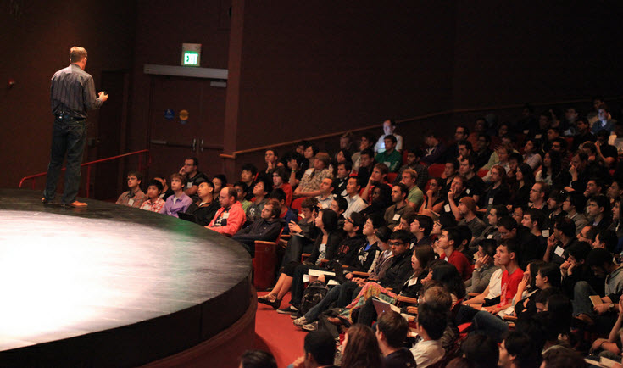
LESSON 1
PRESENTATION AND PUBLIC SPEAKING

Slide 12
Some different types of oral communication
Conversation:
Presentation:
Speech:
spoken exchanges of thoughts,
opinions, feelings...
are usually businesslike,
technical, professional, or
scientific; audience is likely more
specialized
public events like a dedication
speech, a political speech, etc.;
audience is likely to be general

Slide 13
WHAT IS THE FOCUS OF OUR COURSE?
Presentation

Slide 14


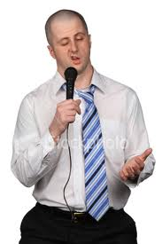



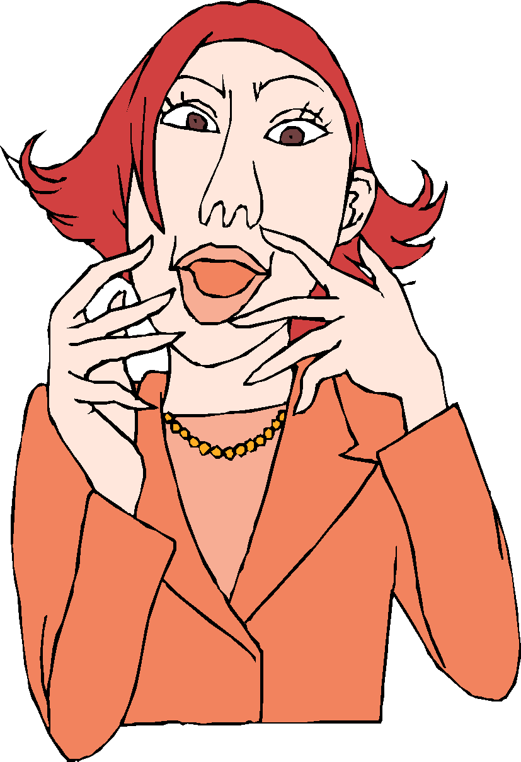
WHICH PRESENTER DO YOU PREFER TO BECOME?

Slide 15
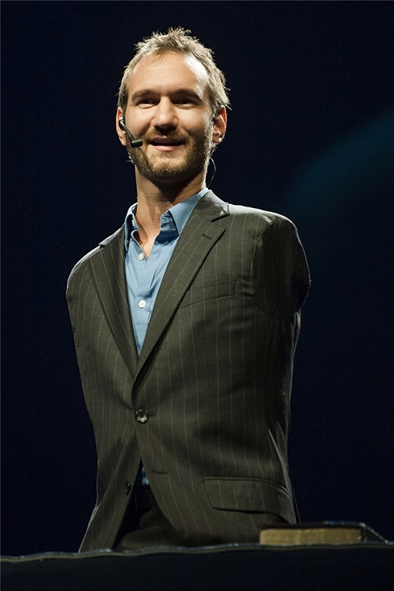
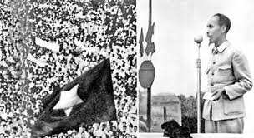
Who’s your favorite speaker and why?

Slide 16
What makes a good speaker?
Knowledge of subject
Preparation of material
Personal credibility
Manner of speaking
Enthusiasm for speaking
Sensitivity to audience
Notes:
16
Every presentation begins with a speaker.
Your success as a speaker begins with you.
You will be asked to speak for a variety of reasons.
Make the best of the situation and be glad for the experience.

Slide 17
“You can have brilliant ideas, but if you can’t get them across, your ideas won’t get you anywhere.” Lee Iacocca
WHAT DO THE AUTHORS MEAN?
"Half the world is composed of people who have something to say and can't; the other half have nothing to say and keep saying it."
Robert Frost

Slide 18

What & How: which is more important?
30% What you know
70% How you
communicate it
Source: CGAP Direct

Slide 19


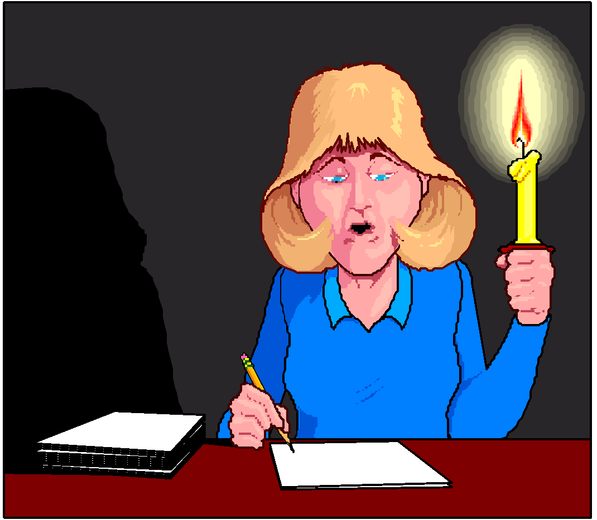
The 3Ps for effective communication
Preparation Practice Presentation

Slide 20




The 4Cs for a good speaker

Slide 21

Care about your audience
Presentations are “by the people and for the people.”
- Without care in your presentation, the audience won’t care about your message.

Slide 22
Clarify your message
- Know exactly what you say and how you say it.

Slide 23
Cut the unnecessary
- “The most valuable of all talents is that of never using two words when one will do.”
Thomas Jefferson

Slide 24
Control your timing
- “Time is gold.” Control the given time limit to score the best.

Slide 25
The 4Cs = K.I.S.S
K.I.S.S = Keep it short and simple!

Slide 26
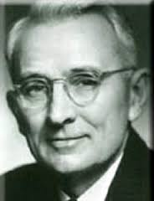
“Great speakers are not born, they’re trained.”
Dale Carnegie (1921)
- Do you want to become a great speaker?
- Let’s take the first step in training!

Slide 27
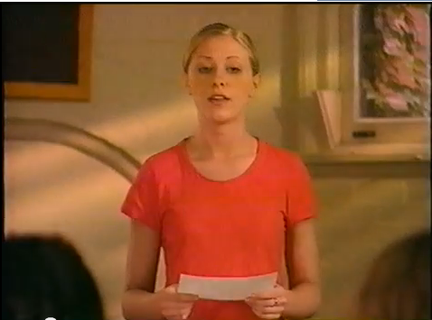
ACTIVITY TIME: Watch a sample self-introduction
A heart worn on my hand
https://www.youtube.com/watch?v=eTTR7d1jr9g
* Note: Google ‘A heart worn on my hand’ to find the video.

Slide 28
Introduction
The blistering sun beats on my forehead as the batter steps to the plate and I prepare to pitch the leather softball nestled in my hand.
As I throw the ball with all my strength, the batter hits a hard line drive right back at me, but I catch the ball in my glove and the batter is out.
Not only has my softball glove saved me from physical harm, but it contains hidden clues to my personality, my background, and the experiences that have helped shape who I am today.

Slide 29
Body
1. On the outside of my glove, you can see my name scribbled in black permanent
marker and water stains surrounding my name.
My name is unique and has given me the courage to stand out from my peers throughout my life.
The water stains come from practicing in the rainy spring weather in Milwaukee, Wisconsin, where I attended high school.
2. As you try on my glove, you notice how easily it conforms to the shape of the hand.
All the individual fingers move together with ease.
This reflects how important teamwork is to me.
I was captain of my softball team my senior year in high school.
I know that to accomplish any major task, everyone must move in the same direction, together.
3. If you look at the seams of my glove, you can imagine all the experiences they -
and I – have been through.
You can see me playing catch with my dad for the first time in my backyard.
You can feel the dirt from my hand after I hit a home run and the joy I experienced after being named first team all-conference.
You can see my mom, dad, younger sister, and older brother always there to support me at the games.

Slide 30
Conclusion
Over time, my softball glove has changed in appearance.
Not only does it reveal important aspects of my life, but the warm tone of the leather shows my aging and transformations as I have grown up.
As the famous basketball coach John Wooden once said, “Sports do not build character, they reveal it.”
Through my softball glove, my character is revealed.

Slide 31
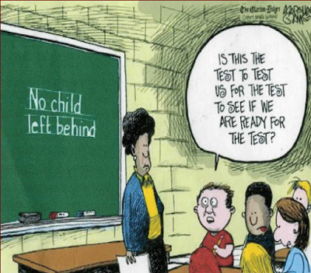


SAMPLE SELF-INTRODUCTION
A 3H Woman
Hard-working Humorous Happy

Slide 32


SAMPLE SELF-INTRODUCTION
1. Hard-working
- Preparing and renewing lessons every semester
- Assessing ‘homework presents’ from students
- Dealing with students’ complaints of all kinds
2. Humorous
- Having fun with students; not being stressed out by them
- Making personal life easier with laughter and smiles
3. Happy
- Motivation and rewards from students
- Encouragement and sharing from family

Slide 33
Check what you know
AE2 Speaking course description?
What makes a good speaker?
3P Principle for effective presentation?
4C Principle for a good speaker?

Slide 34
Assignment 1: Plan a 2-minute self-introduction
Your individual presentation is scheduled in Week 2.
You register in-class or video presentation in the link below.
- Your self-introduction must have 3 parts: Introduction, Body, and Conclusion (as in the sample script above).
- It is about ONE TOPIC/ASPECT (name, hobby, or future plan, etc.) that makes you special or unique in the world. It is NOT incoherent details about your background (age, major, family members, hobbies, and future plans).
- The script/outline and video of your presentation is submitted to the link.
- Important: Your first effort counts for your 30% of class participation, so please take good care.
You can make your video with subtitle like this:
https://drive.google.com/file/d/1ShJHEI-zN9kIENiH9eTTqpmly1ost1TS/view?usp=sharing

Slide 35
Links to submit Self-introduction script + video:
Group 24:
https://drive.google.com/drive/folders/1sZTo1LYU0lG_r_Mzqe_29Ki-9xSfFcEh?usp=sharing
Deadline: End of Friday next week

Slide 36




Your first try

Slide 37
DORAEMON
Introduction: a KFC friend
Body:
- Kind-hearted
+ Be always ready to help anyone without asking for returns
+ Whenever Nobita gets bullied, I'm always by his side
+ Always facilitate Nobita to fulfill his wishes with future technologies
- Friendly
+ I can make friends easily with anyone I met (example)
- Caring
+ Though just being a robot, I'm a good listener who always listens to your problems and gives you the best advice
Conclusion: restatement

Slide 38
Thank you and see you next time ☺

Slide 39
Week 2
Self-introduction

